Slide 1
N8N Workflow
Book Recommendation

Slide 2
Workflow Overview
A Book recommendation system that gathers data online from the Open Internet Archive and gives book recommendations via mail if there are any present. It works automatically on time schedule as well as on click.

Slide 3
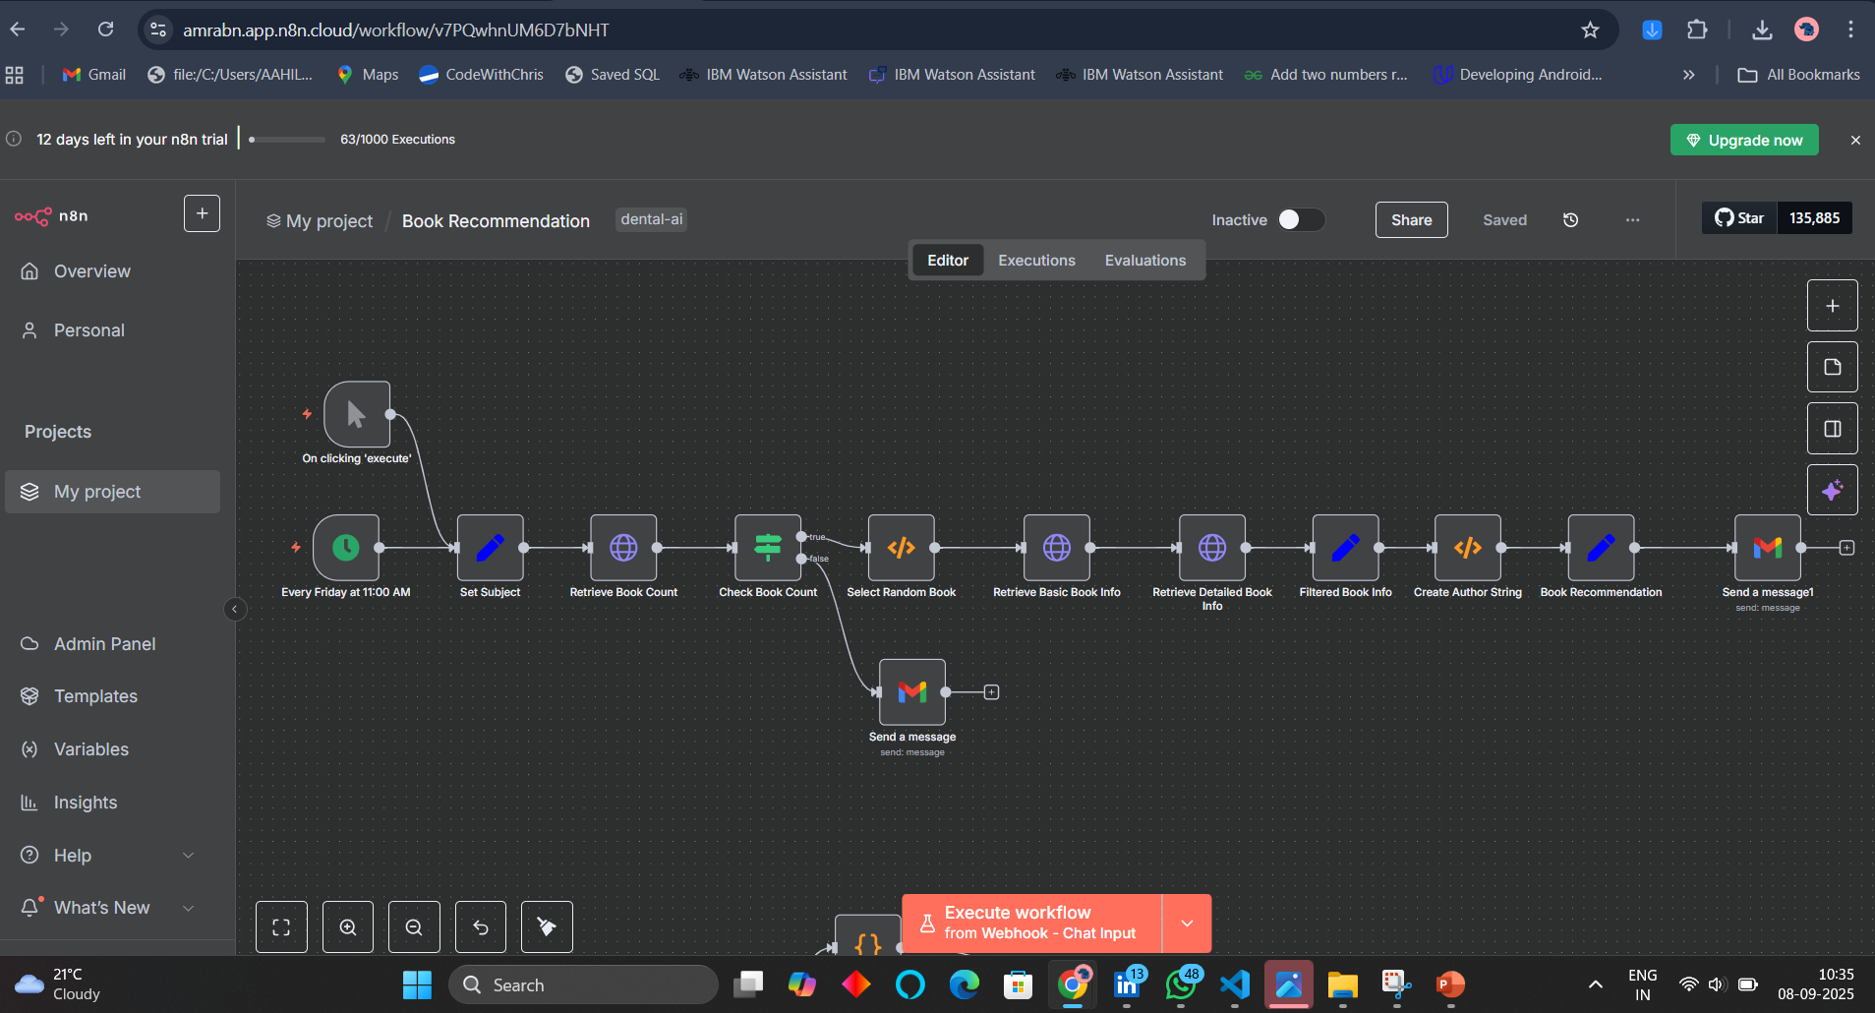
Screenshot of Workflow

Slide 4
Flow Explanation
1. Triggers
Manual Trigger ("On clicking 'execute’”)
Let’s you test or run the workflow manually.
Cron Trigger (“Every Friday at 11:00 AM”)
Automatically runs the workflow weekly at the set time.
Both triggers connect to the next step, so you can test or schedule.
2. Set Subject
Static subject = juvenile_literature
This defines which subject/category of books the workflow will query from Open Library.
3. Retrieve Book Count
Sends a request to:
http://openlibrary.org/subjects/juvenile_literature.json?limit=0
Retrieves metadata about the subject.
Most importantly → work_count (total number of books in that subject).

Slide 5
Flow Explanation
4. Check Book Count (IF node)
Checks if work_count > 0.
Yes path → continue with random book selection.
No path → send a Gmail notification saying “No books available for this subject.”
”
5. Select Random Book
Uses a Function node to:
Generate a random number between 1 and work_count.
Saves it as retrieve_book.
This ensures each run picks a different random book.
6. Retrieve Basic Book Info
Calls:
http://openlibrary.org/subjects/{subject}.json?limit=1&offset={retrieve_book}&detail=true
Gets the basic info for that randomly selected book.
Includes title, authors, key (book ID).

Slide 6
Flow Explanation
7. Retrieve Detailed Book Info
Calls: http://openlibrary.org/{works[0].key}.json
Fetches detailed metadata, including book description.
8. Filtered Book Info (Set node)
Extracts and keeps only the useful fields:
authors (array of author objects)
title
description
URL (book’s Open Library page link)
9. Create Author String (Function node)
Converts authors array into a formatted HTML string:
Example:
<a href="https://openlibrary.org/authors/OL12345A">J.K. Rowling</a>, <a href="...">Another Author</a>
Joins multiple authors with commas.

Slide 7
Flow Explanation
10. Book Recommendation (Set node)
Creates two variables:
msgSubject → "Book Recommendation: [Title]"
msgBody → HTML content:
<H2><a href="book_url">Book Title</a></H2>
<p><em>By Authors</em><br>
Book Description</p>
11. Gmail (Send Recommendation)
Sends an email to nadafamra@gmail.com with:
Subject = msgSubject
Body = msgBody
The email contains a clickable book title link, formatted authors, and description.
12. Gmail (Send Failure Message)
If no books were found (from IF node fail path), sends an email:
Subject → "Book not found in juvenile_literature"
Body → Suggests checking Open Library subjects page.

Slide 8
End Result
Every Friday at 11:00 AM (or manually)
A random book from juvenile_literature is fetched.
Its details are formatted into a neat email.
Email is sent to you with book info.
If no book exists: You get a failure notification instead.

Slide 9
Output Screenshots
Smart Email assistant

Slide 10
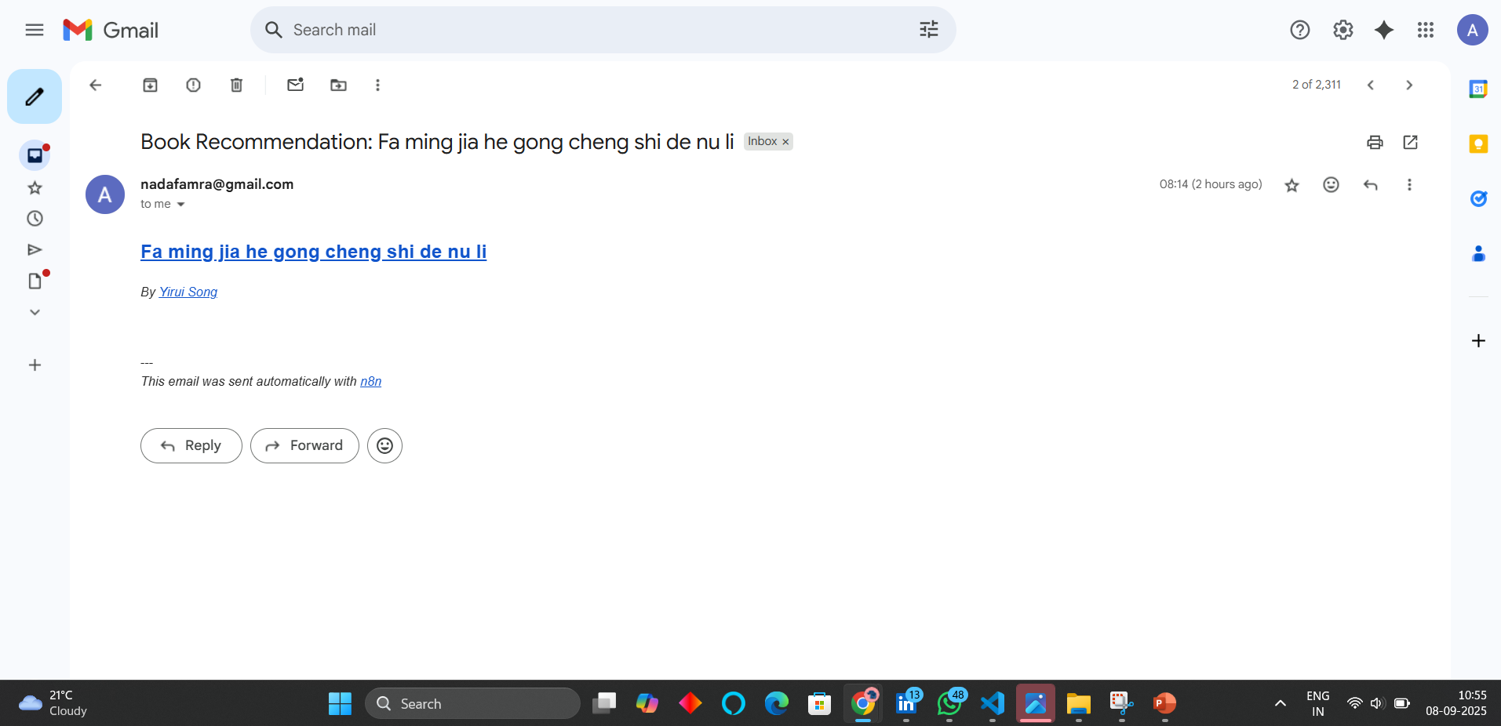
Output Gmail with a recommendation

Slide 11
Thank You!

